Slide 1

Turnout Time Machine Learning
Corey Davidson, Sarah Rosenquist, and Patrick Bourke

Slide 2
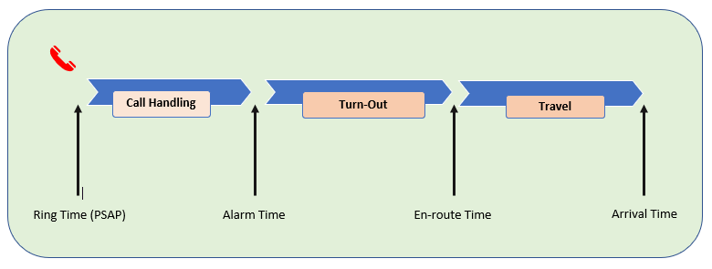
What Are We Predicting?
We want to see if there is any way to use machine learning to predict the effect of multiple variables on turnout times. The turnout time is the time between when a call is received at a station and when a unit leaves the station in response.

Slide 3
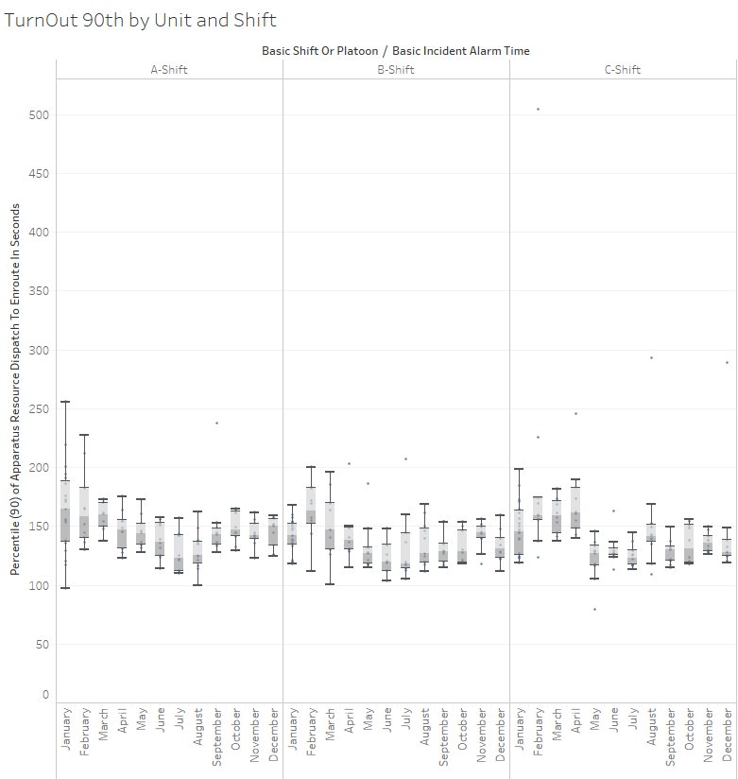
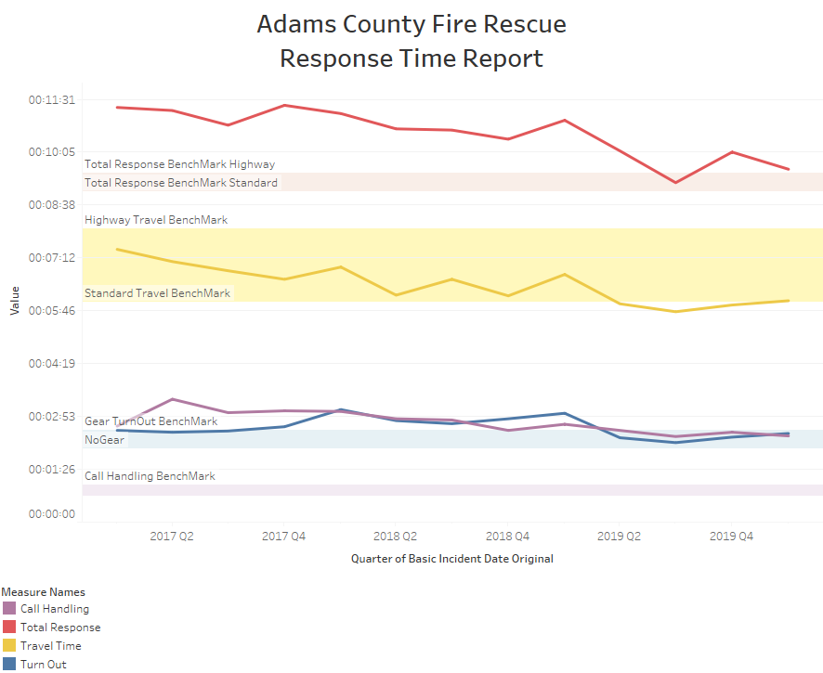
Tableau Visualizations

Slide 4
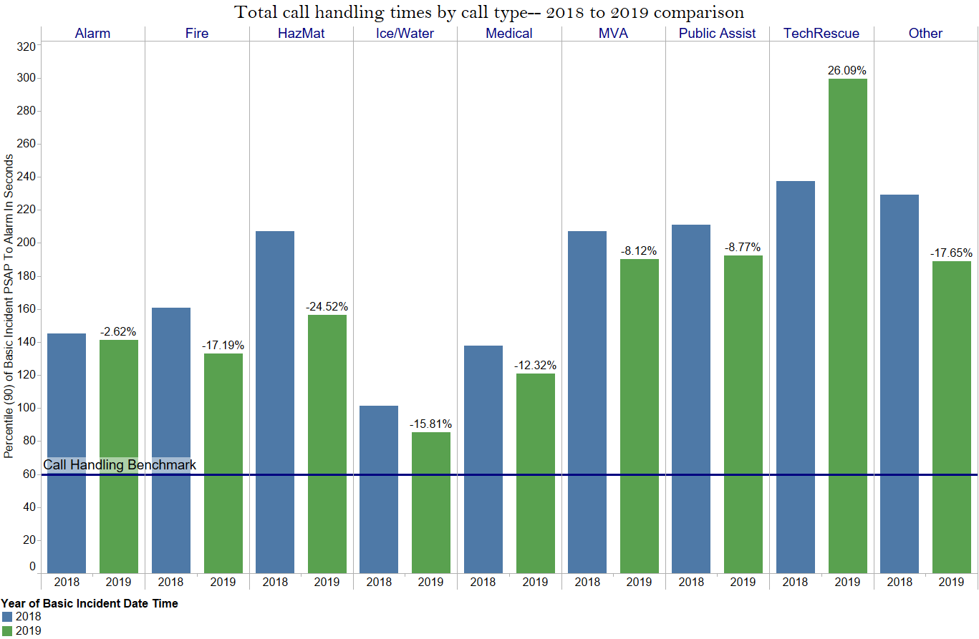
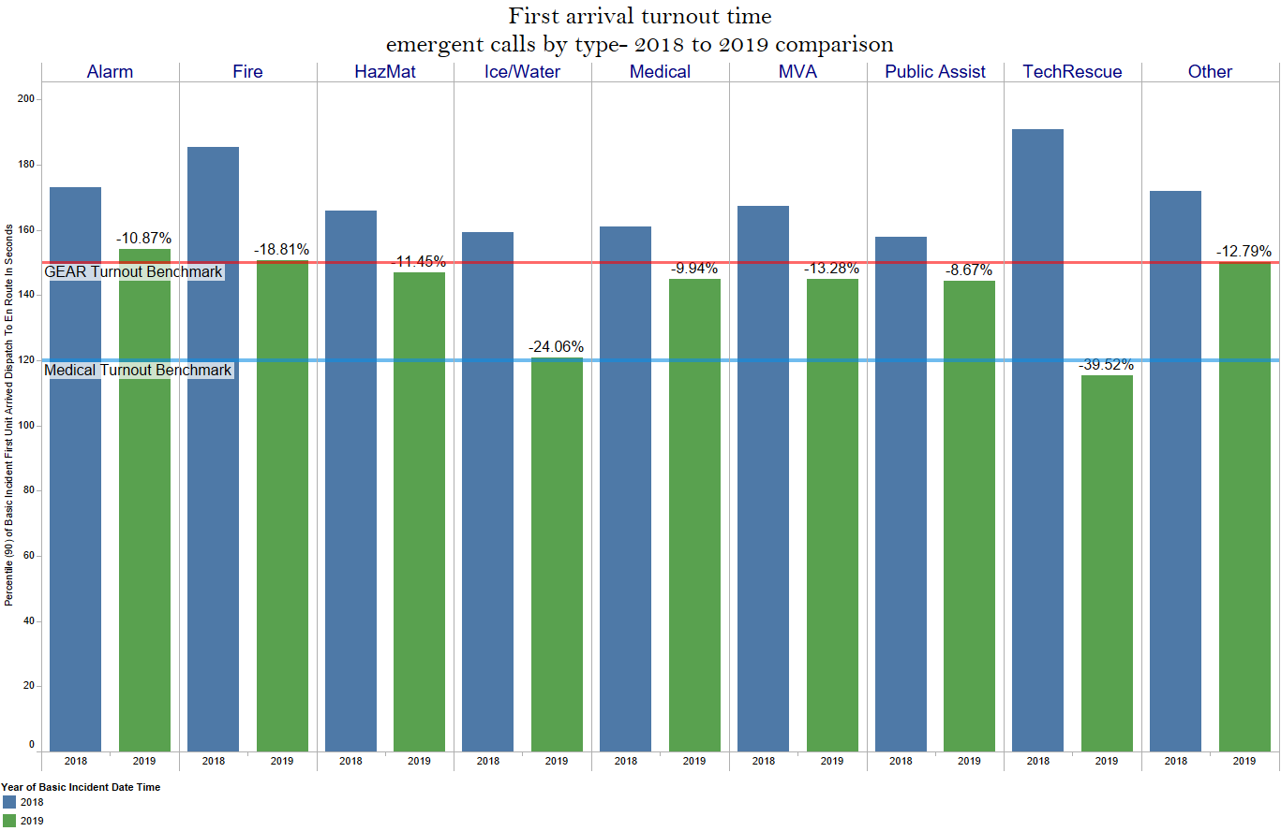
Tableau Visualizations

Slide 5
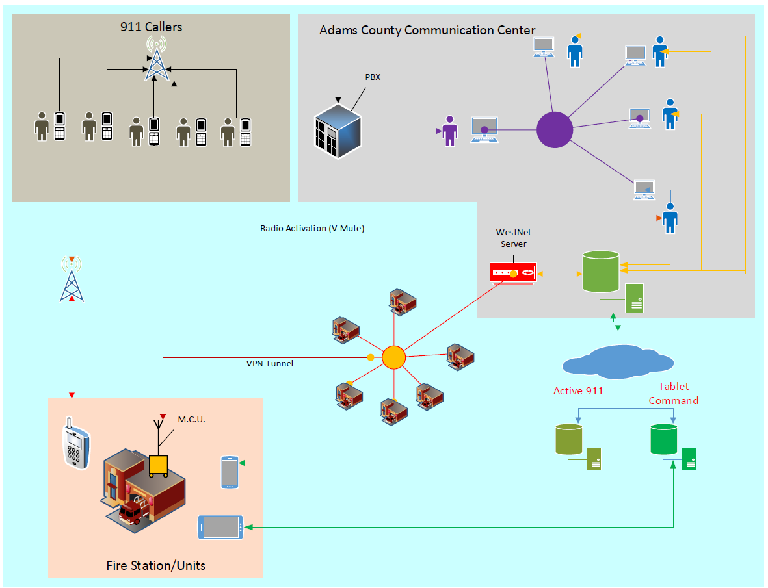
Microsoft Visio-Schematic

Slide 6
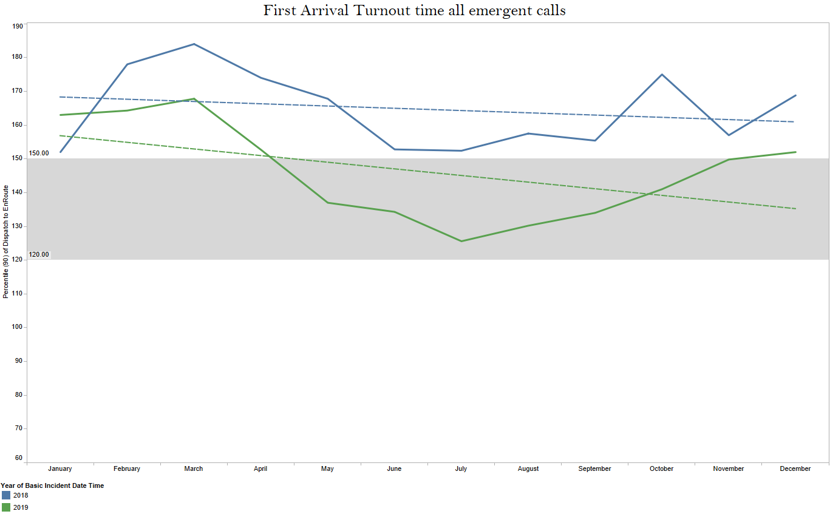
First Arrival Turnout Time

Slide 7
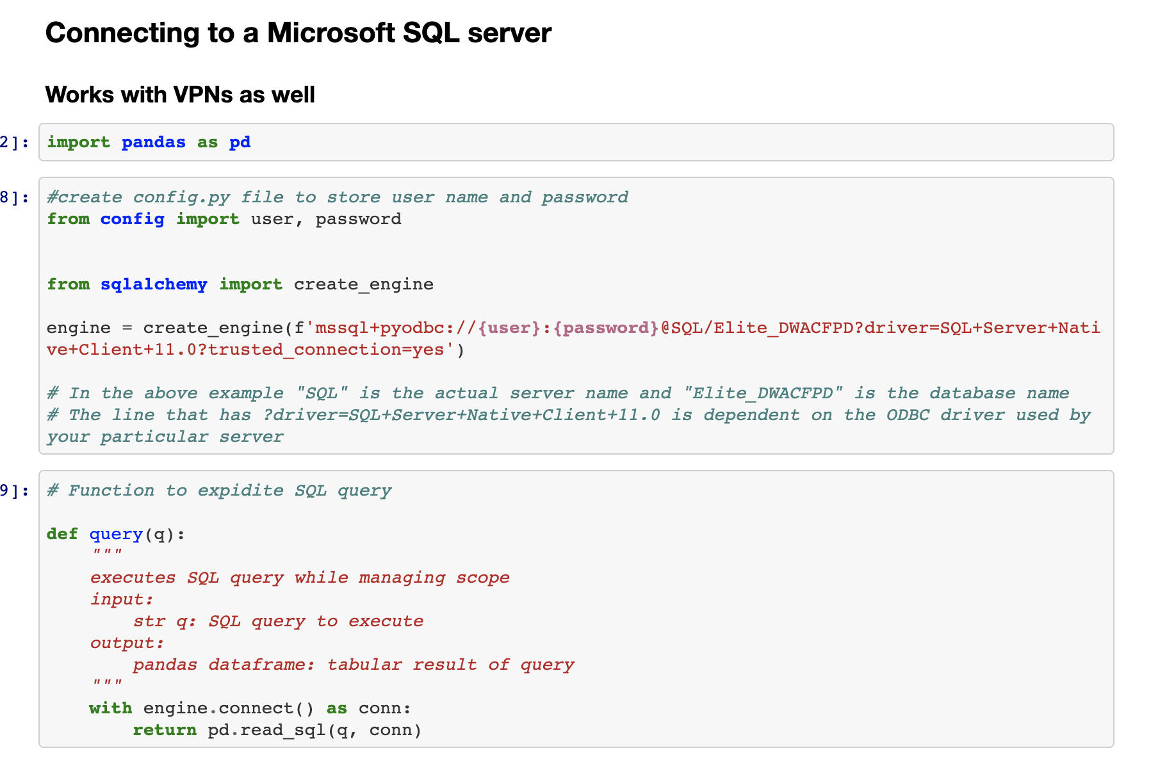
Where did we get the data?
For The Weather Data, we were able to download the data directly from NOAA’s site, and then compile it into a CSV in Excel.
File "Conn_MSSQL" contains the code we used to access the database through a VPN. Then we wrote a SQL server to extract the data into a csv file for the Call Data.

Slide 8
Data Cleaning
For the data cleaning we used Python. This is when we concatenated both the Weather data and the Call Data. We used ”-” as a delimiter and pulled the station number out of the Unit ID.
Next we put our date columns into date time format then took the difference between unit turnaround time and dispatch time to find out how many seconds it took the unit to respond. We repeated this step to calculate unit travel time.

Slide 9
Data Cleaning Con.
We then needed to pull in weather data for the time period in our dataset in order to see if weather had an affect on turn out times.
We merged the TurnOutTime dataframe and the TravelTime dataframe with our weather data frame and cast the dates into datetime format.
We then needed to categorize a few things in order to perform machine learning. To do this we created two dictionaries. One to categorize the time of day based on the hour of the call into "Day", "Night", or "Evening". We categorized incident codes by type of incident as well.

Slide 10
Machine Learning
We started by using OneHotEncoder to categorize Time of Day and Station Number. We then merged the two dataframes with the binary information.
We then assigned our x and y and fed them into the train test learn function to show our prediction.
We ran a random forest regression. This showed that no strong correlation could be found to predict if weather has an impact on Turn Around Time.
We ran features importance function to show how the machine is weighting each feature. We also used rf.predict to show some of our predicted values.

Slide 11
Machine Learning Con.
We ran another Random Forrest Classification based on the incident type to show if there was a correlation between the types of incident and weather. We followed the same steps above to do so.
When we did this we determined the machine did not learn anything because about 74% of the data was one type of call. This means the machine can guess accurately just by guessing the most used type of call without factoring in much else. We decided to do a confusion matrix to show that.
We wanted to visualize the correlation between factors in our model. Ultimately, we were unable to show the correlation between weather and our categorical incident types.

Slide 12
Machine Learning Con.
Once we had an evenly weighted dataset, we followed the same steps to do the Random Forest Classification and do another confusion matrix. This time the machine predicted the accurate incident type based on weather with 45% accuracy. This is a much more realistic number and that is shown in the confusion matrix.

Slide 13
Conclusion On Machine Learning
We were unable to make the machine predict a turnout time on any of the associated variables, which included weather (precipitation, snowpack, minimum temp., maximum temp., and average temp.), type of call, time of day, and turnout time.

Slide 14
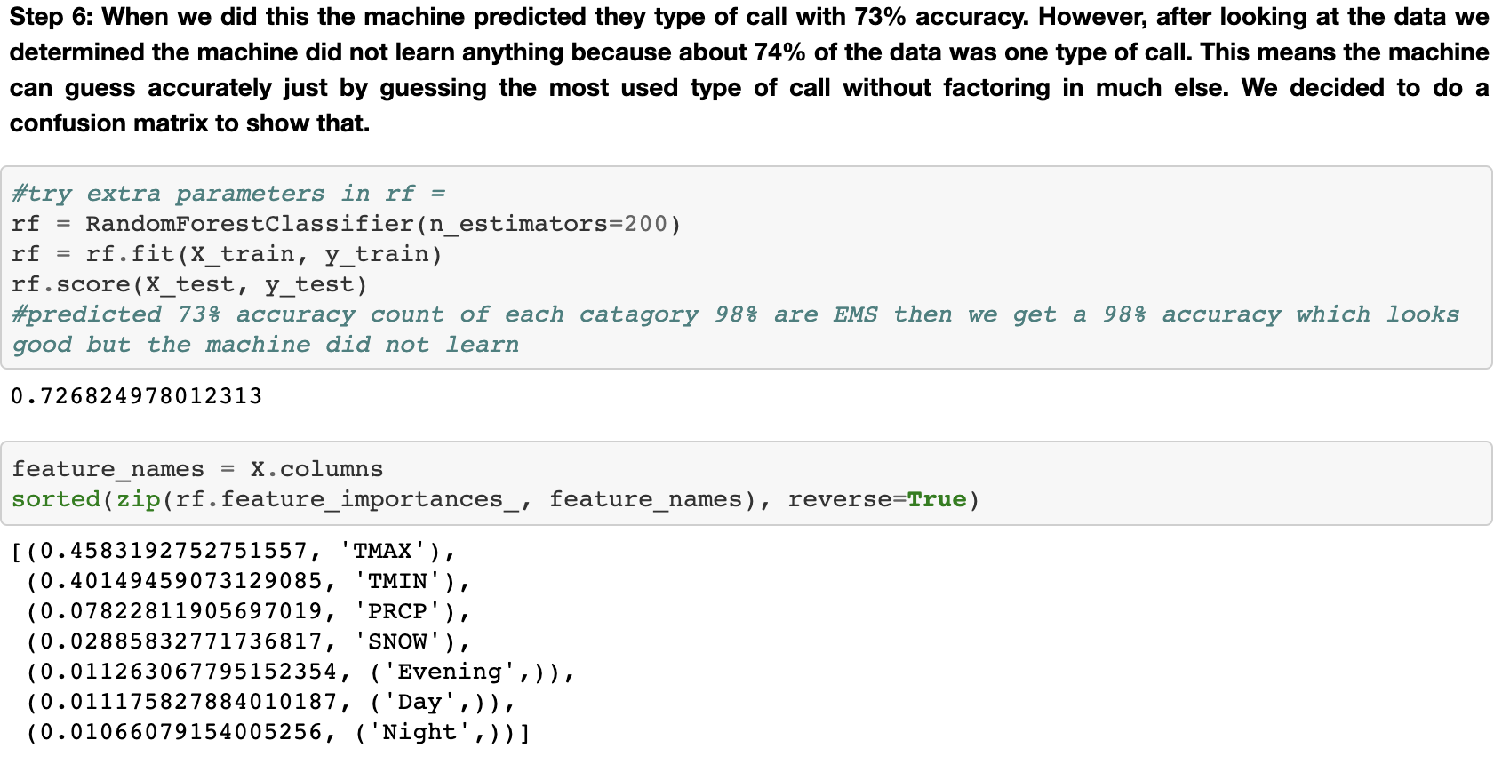

Slide 15
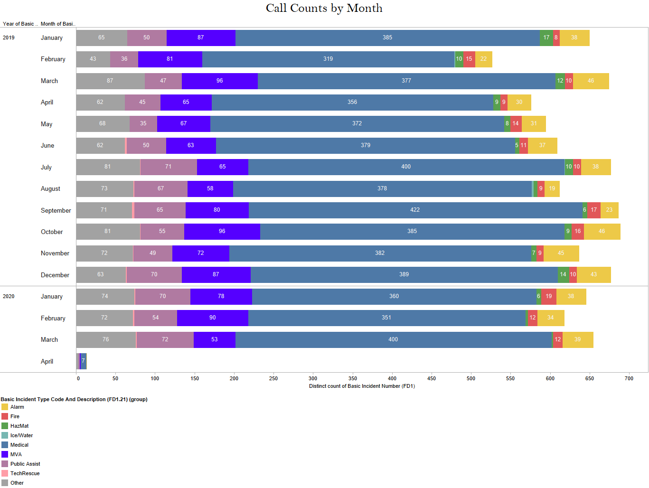
Tableau Visualizations

Slide 16
That’s All Folks!!

